Slide 1
SoC: Image Processing and Object Detection
Tausif Shahanshah
22M0329
MTech (CSRE)

Slide 2
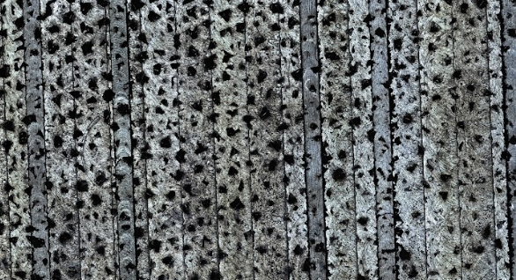
Problem Statemen
I have to develop Python script to determine the % porosity of the surface of a porous metal.
% porosity is calculated as
the number of pore pixels/total pixels in
the image.
The image is provided along with the problem.
The image shows the top view of a porous
metal. The dark pixels are the voids
or pores, and the bright pixels depict the metal.

Slide 3
Proposed Solution
Applied Gaussian Blur
To reduce noise from the image.
It is widely used filtering technique that works by convolving the image with a Gaussian kernel.
In this case, a Gaussian kernel of size (15, 15) is used with sigma set to 0.

Slide 4
Proposed Solution
Converting to grayscale
Convert the blurred image to a grayscale image.
Grayscale images represents the intensity levels only as opposed to RGB in color image.
It simplifies further processing and reduces memory usage.

Slide 5
Proposed Solution
Binarising the Image
It converts the grayscale image into a binary image
Each pixel is either black (0) or white (255) based on a threshold value
In this case, a threshold of 72 is used, pixels with intensity greater than 72 is considered as white(255) and pixels with intensity less than 72 is considered as black(0).
Pixels with grayscale value 0 are pore pixels.

Slide 6
Result
Total Pixels are calculated as 72751314
Pore pixels are 22638212
The percentage porosity comes out to be 31.12%.

Slide 7
Thank You!!!

